Slide 1

M/S-RISE AUTOMATION (New Delhi) WE ARE DOING FULLY AUTOMATION MILK AND PROCESS PLANT

Slide 2

OUR CLIENTS
FEDILITY AGRO
NAMASTE INDIA
VRS FOODS LIMITED(PARAS)
VERKA MILK
SARAS MILK
MODERN DAIRIES LIMITED
PARAM DAIRIES
ANANDA FOODS LIMITED
DS FOODS
GOVIND JI DAIRIES
LOTUS DAIRIES
MODI DAIRIES
ANNEJA FOODS
CONTINENTAL MILKOS
JAY SHREE GAYTRI FOODS
BK ANAND FOODS
RAMSON DAIRIES
MANFEEDS
PREMIER AGRO(PRAYAG)
RICELA FOODS
CREMY FOOD

Slide 3
OUR OEM
FOOD AND BIOTECH
YSM DAIRIES BIOTECH
ATHENA PROCESS
G-MAC
IDMC
APV
GEA
AP INC
DMECH ENGINEERS
KR ENGINEERING AND CONSULTANT
MECTECH PROCESS
BAJAJ PROCESSING

Slide 4
FULLY AUTOMATION PROJECT
MILK RECEPTION (DOCK)
RAW MILK SILO(RMS)
MILK PASTURIZER
PASTURIZED MILK SILO (PMS)
MILK SEPRATOR
CREAM PASTURIZER
EVAPORATOR
CRYSTALIZER
DRYER(Roller dryer, wen dryer)
DECANTOR
MILK RECONSTITUTION(RC SECTION)
CIP
AHU AUTOMATION
PRDS AUTOMATION
REFRIGERATION
MACHINE AUTOMATION
BOILER AUTOMATION

Slide 5
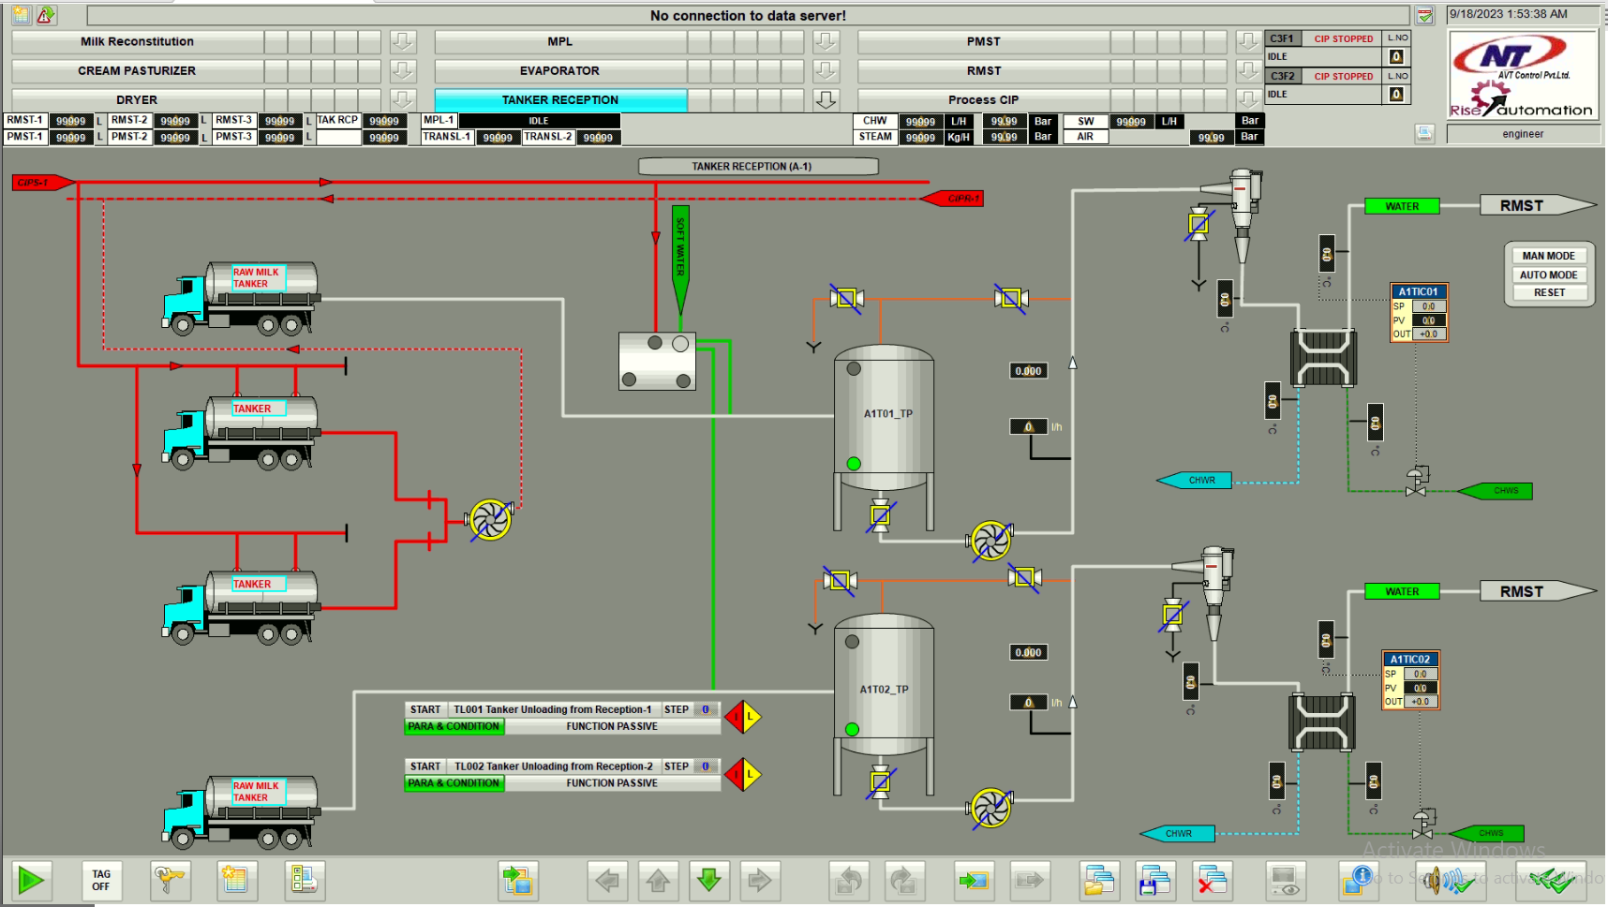
Fedility Agro,Malanpur (MP) MILK RECEPTION

Slide 6
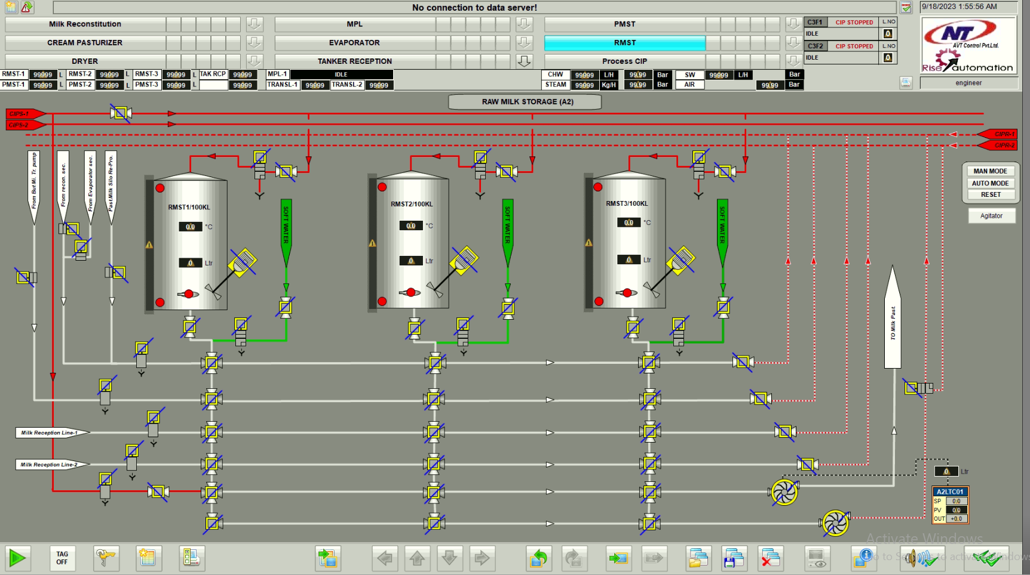
RAW MILK STORAGE SILO

Slide 7
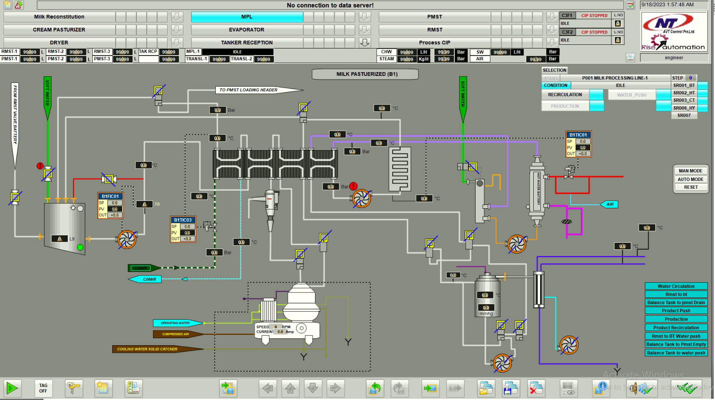
MILK PASTEURIZER

Slide 8
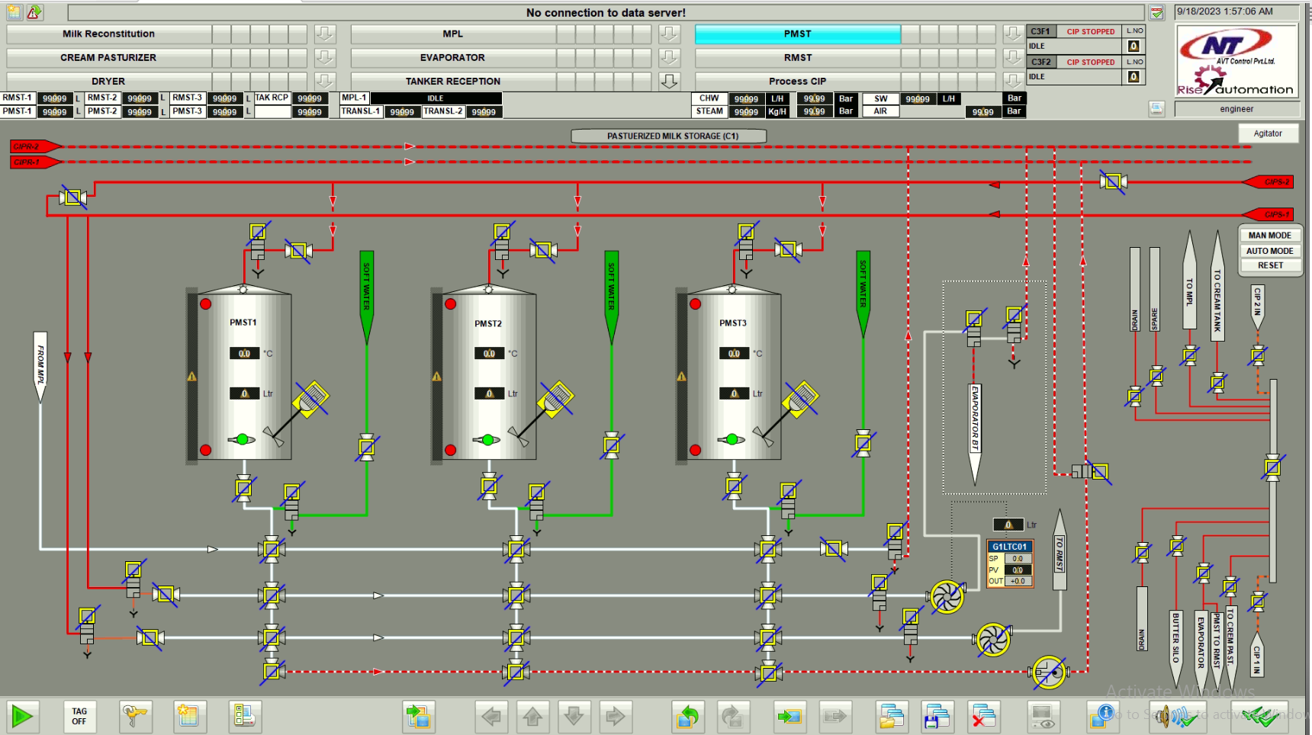
PASTEURIZED MILK SILO

Slide 9
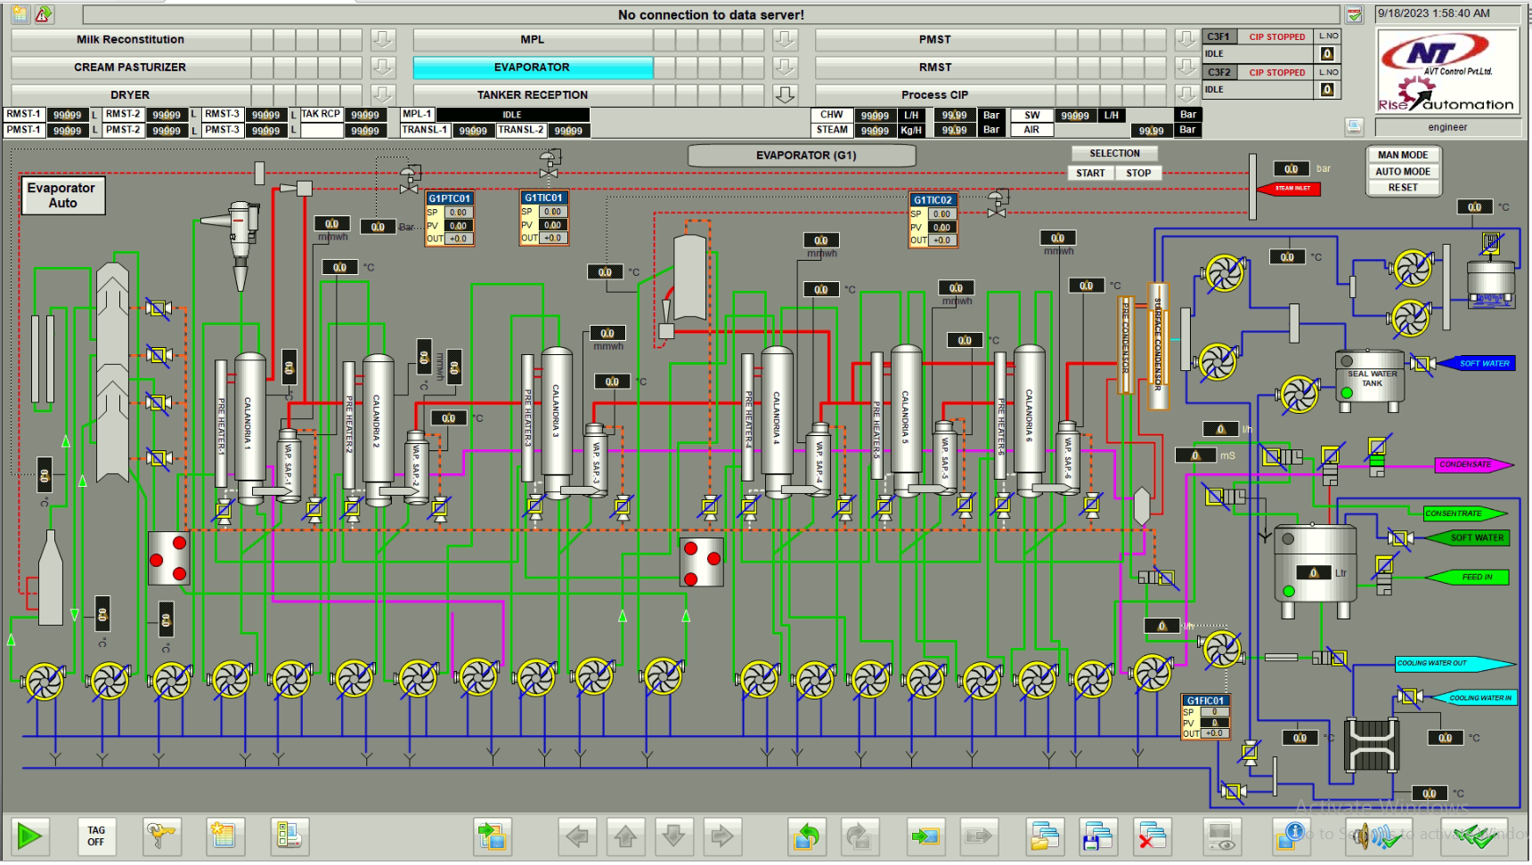
EVAPORATOR

Slide 10
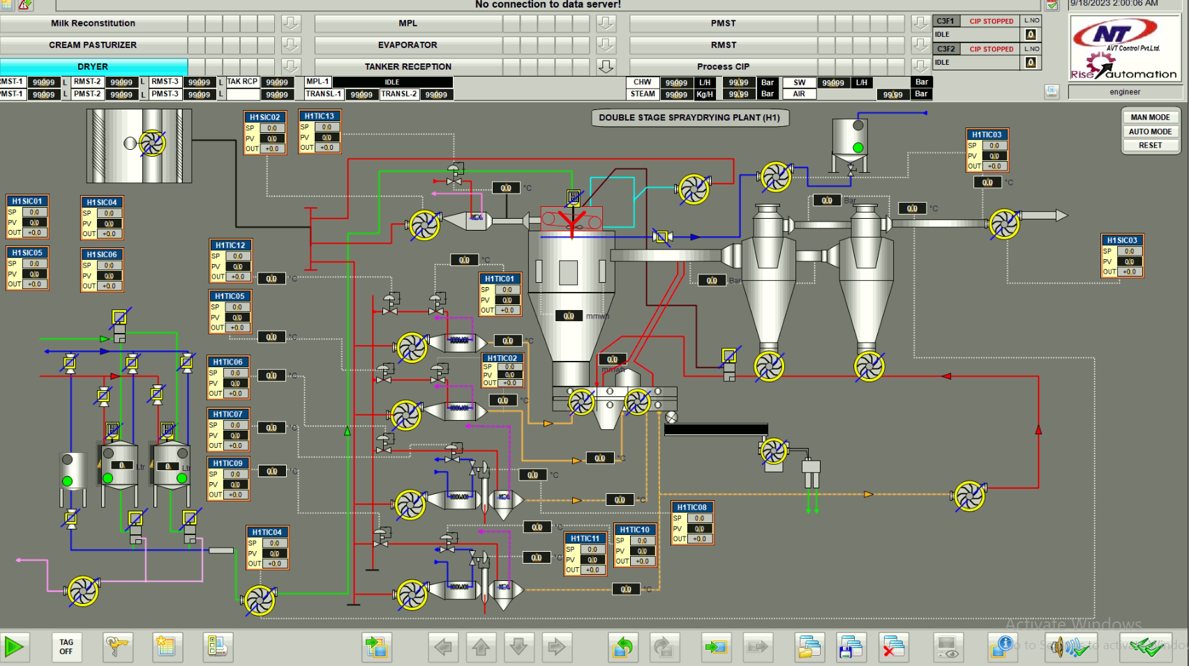
DRYER

Slide 11
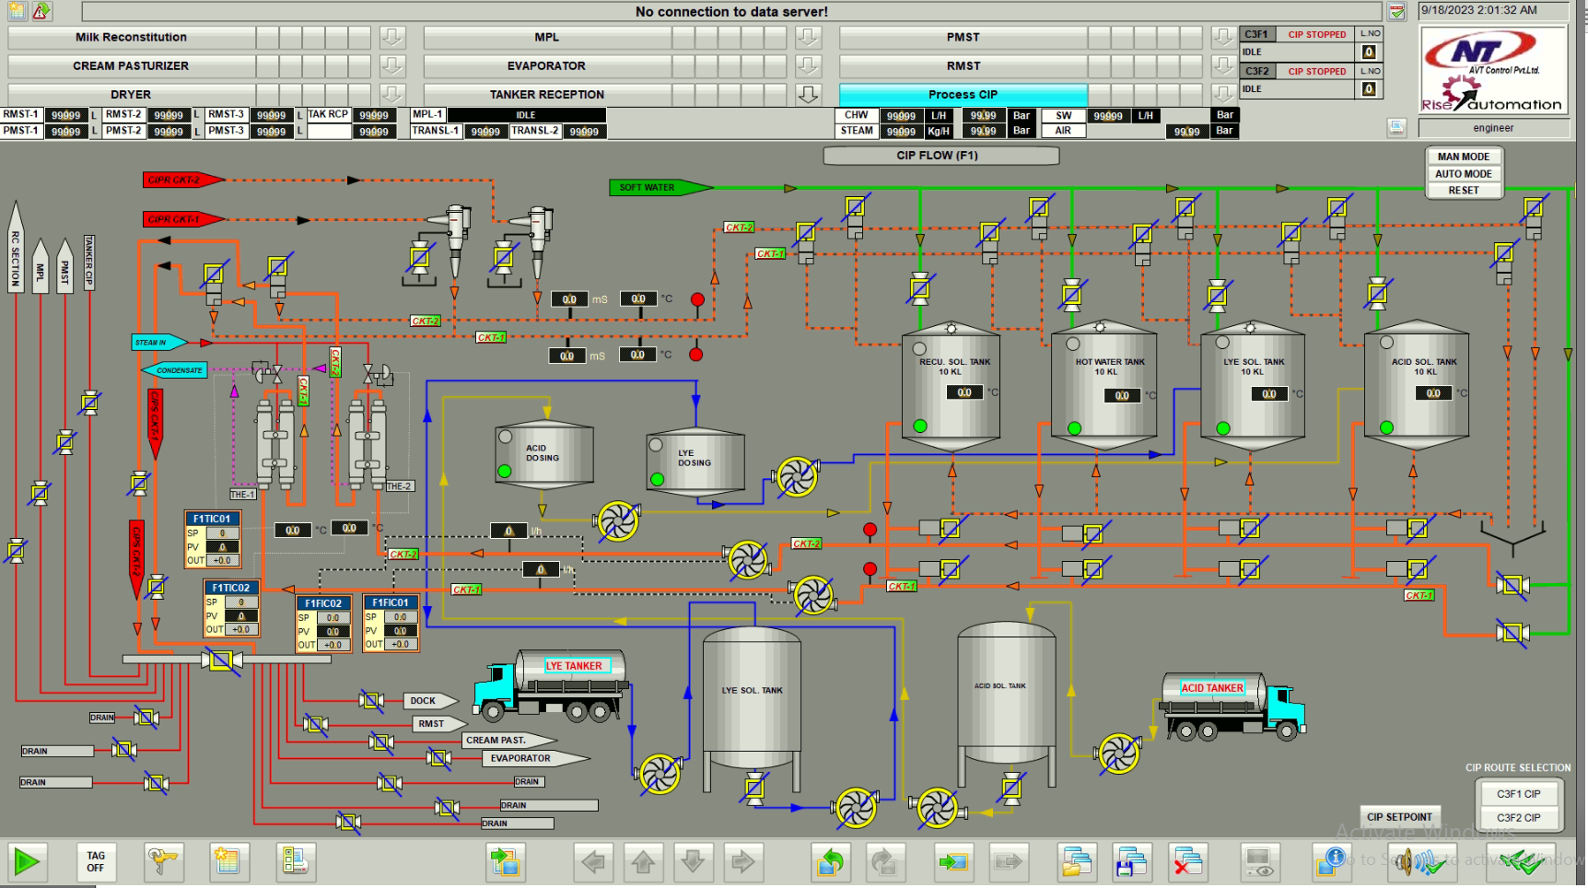
CLEAN IN PROCESS (CIP)

Slide 12
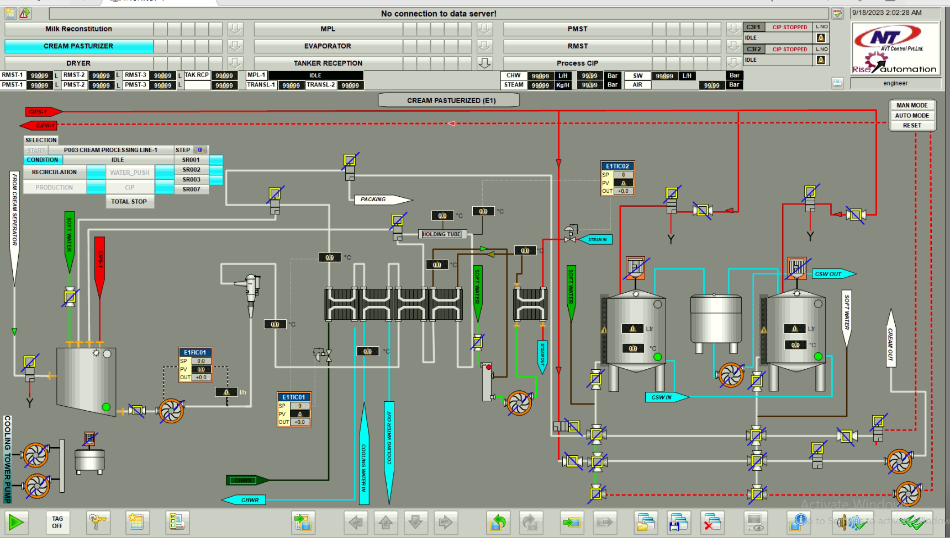
CREAM PASTEURIZER

Slide 13
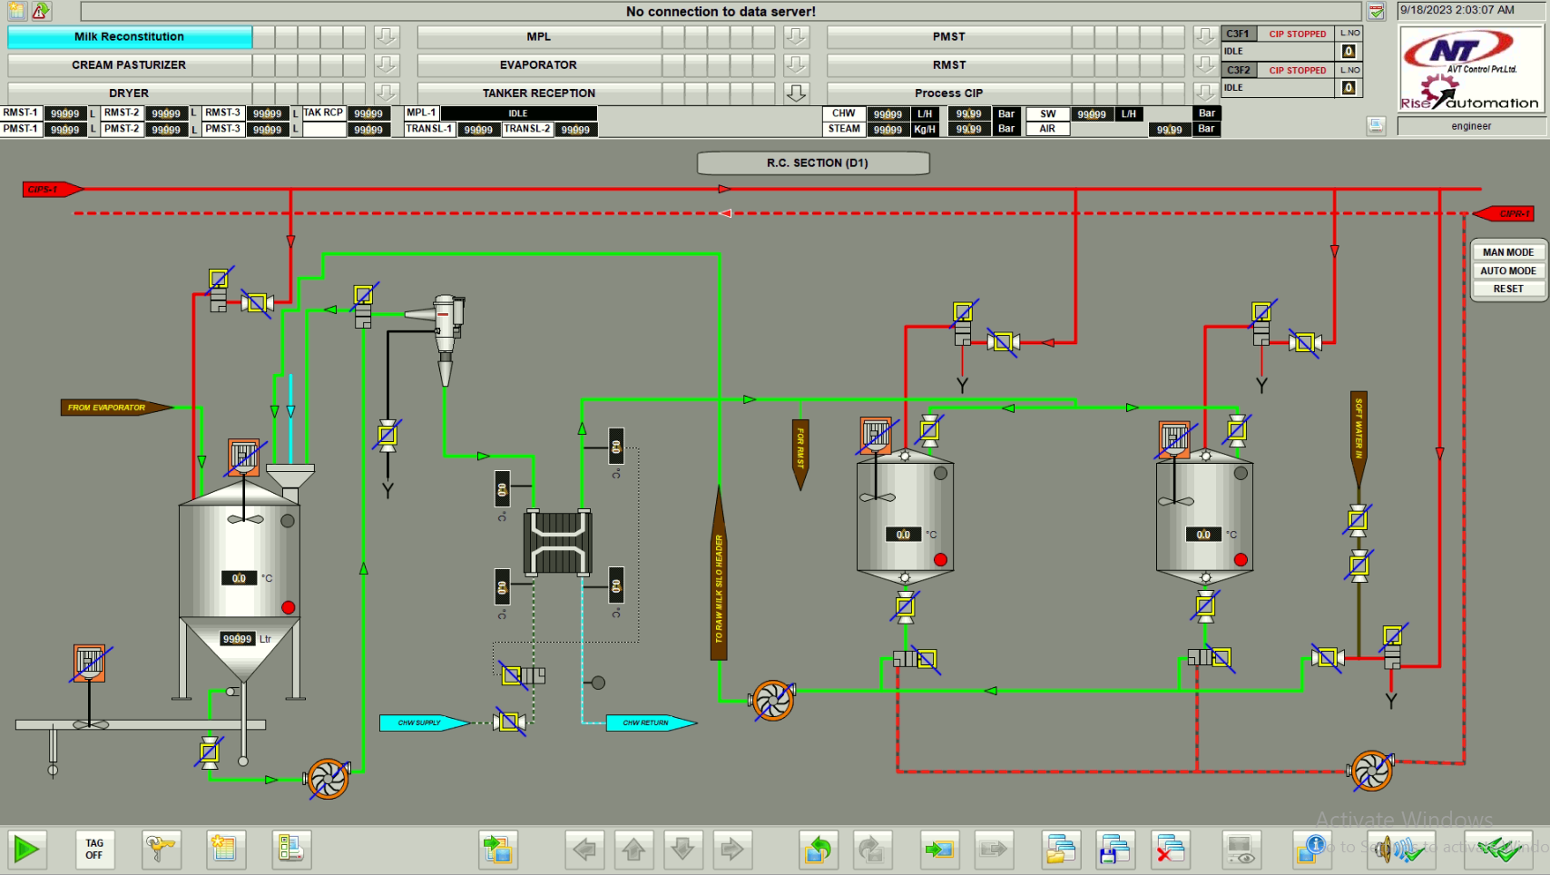
RC SECTION

Slide 14
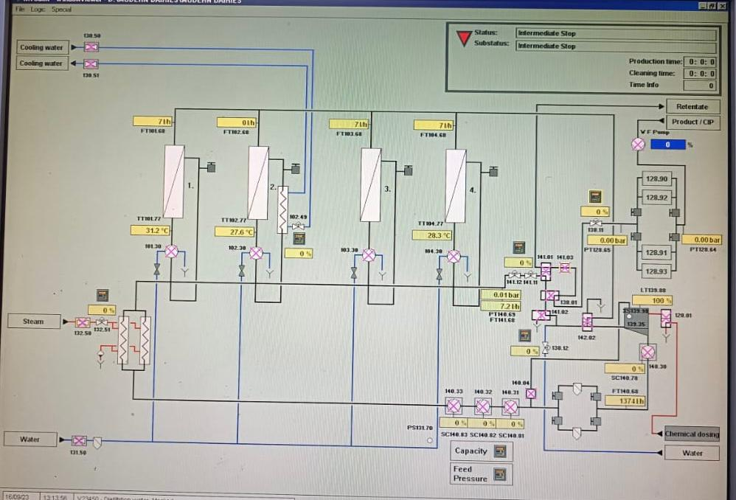
Modern Dairies limited NF-PLANT

Slide 15
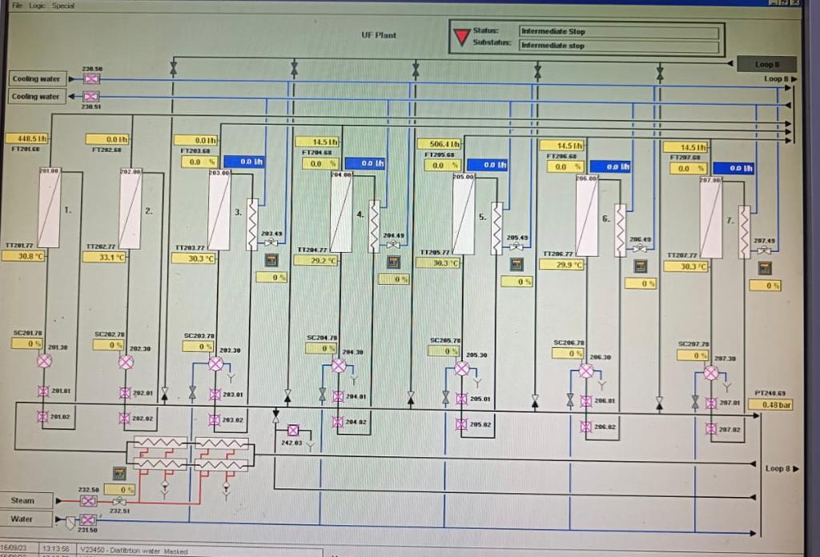
Modern Dairies limited UF-PLANT

Slide 16
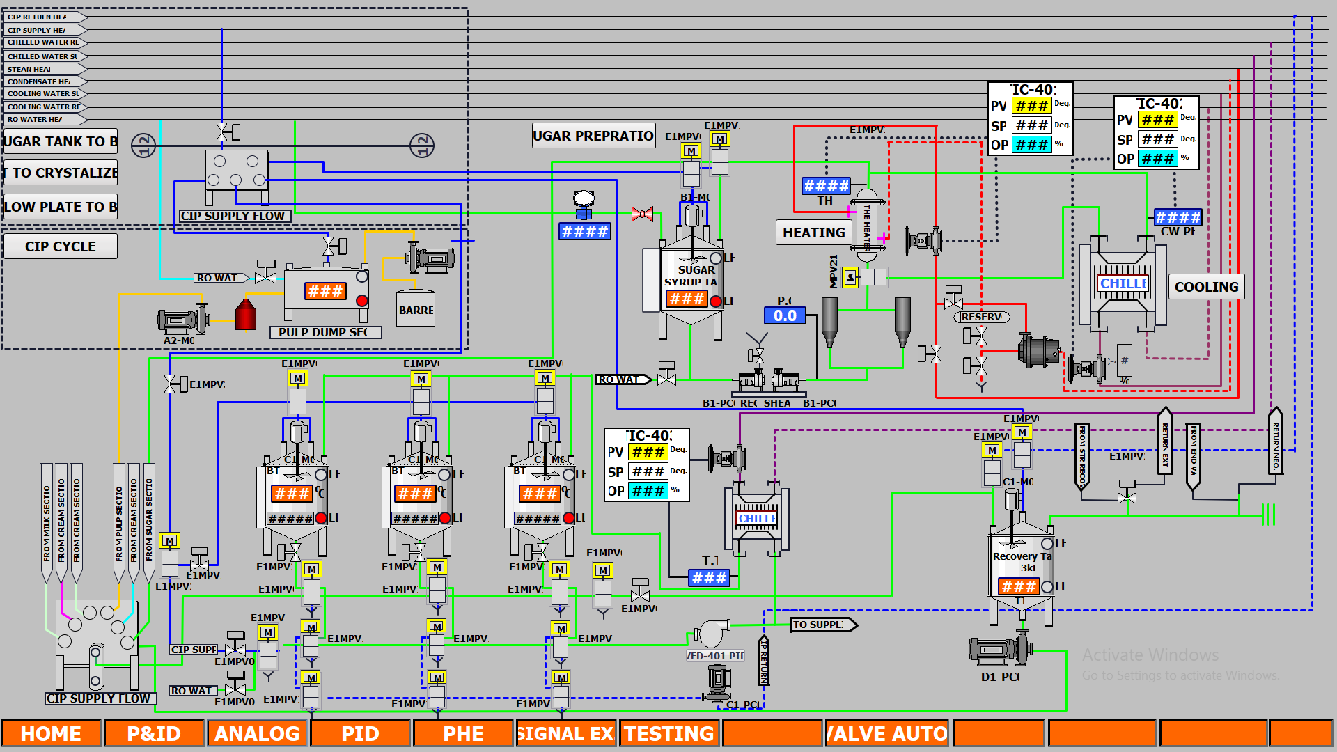
Ananda Foods Sugar Syrup

Slide 17

THANKS for YOUR SUPPORT and PATRONIZING

